Slide 1
ANAYILDIZ TEKSTIL
2017-2018 UNDERWEAR - PAJAMAS COLLECTION
www.anayildiz.com

Slide 2
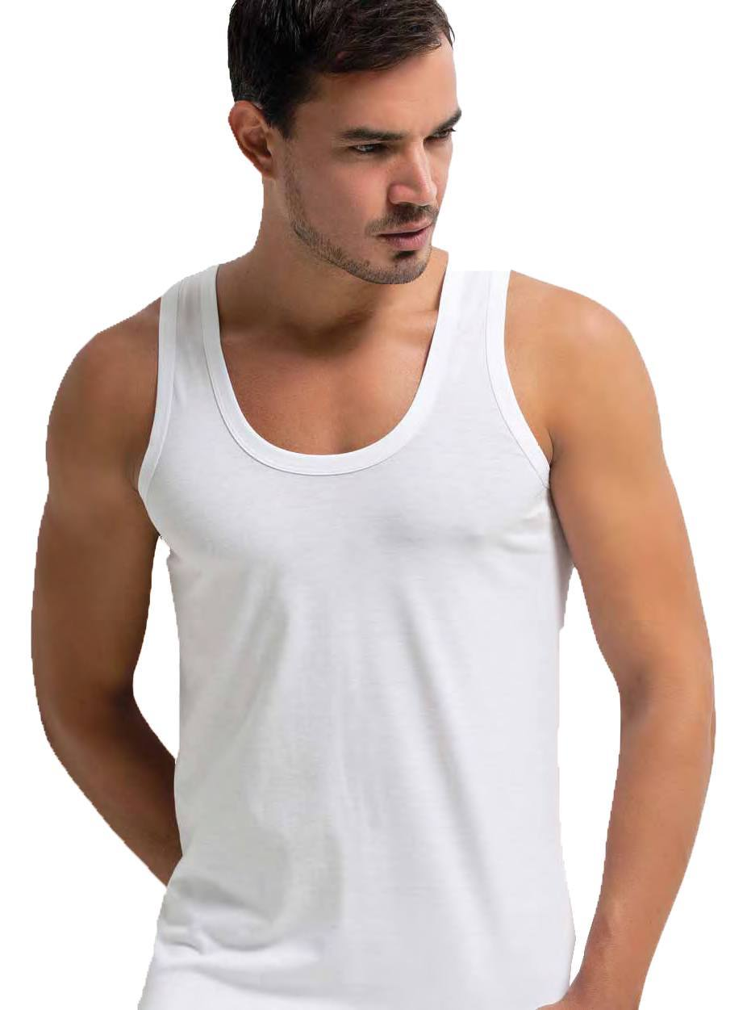
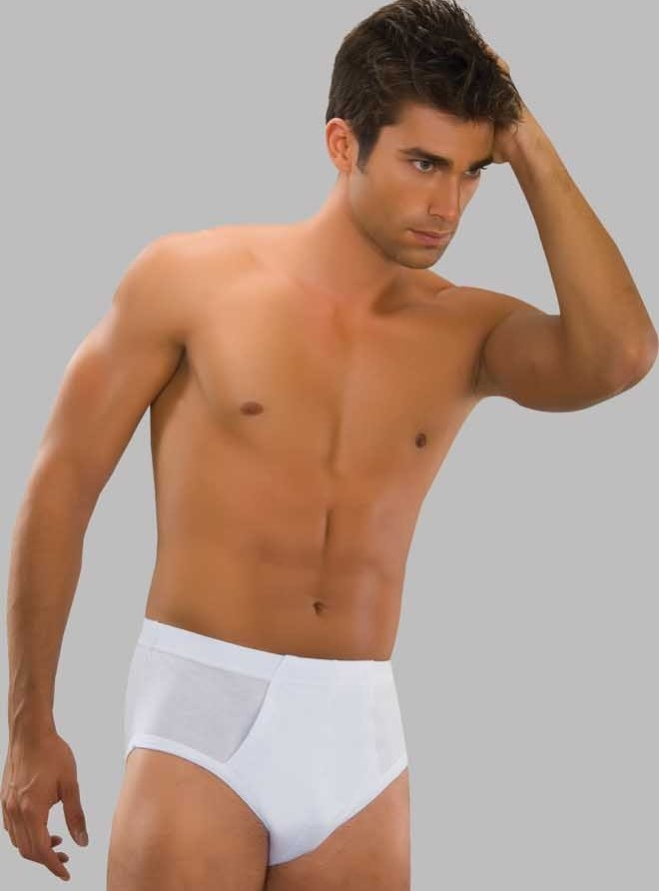
ANAYILDIZ TEKSTIL
Code: 1001
Code: 1002
Code: 1003

Slide 3
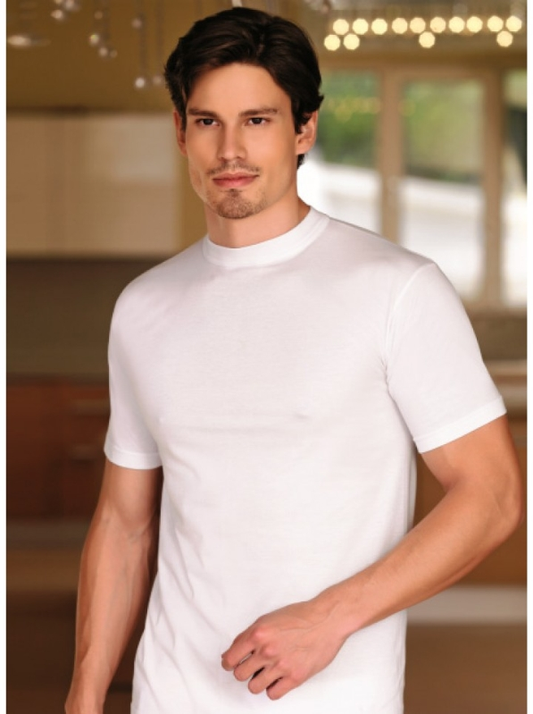
ANAYILDIZ TEKSTIL
Code: 1004
SIZE: M-L-XL-XXL
Code:1005

Slide 4
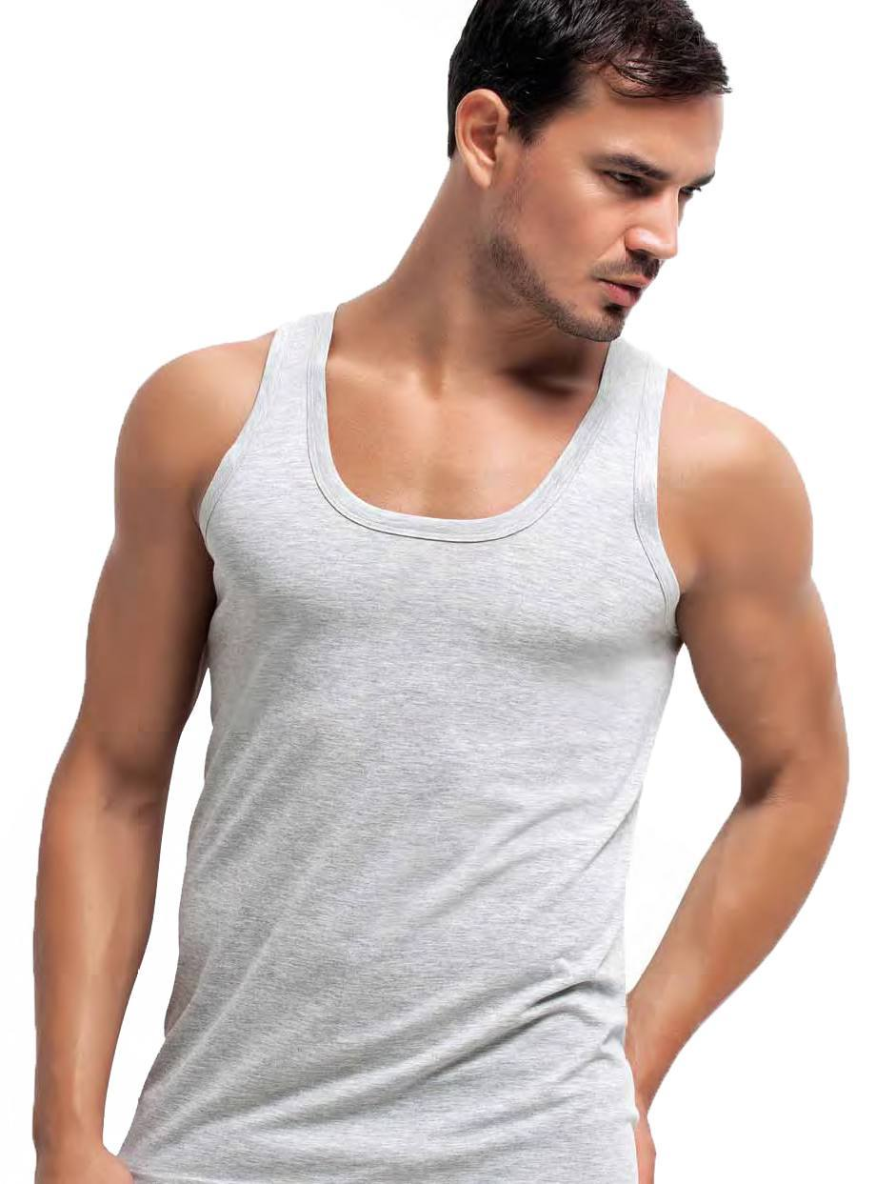
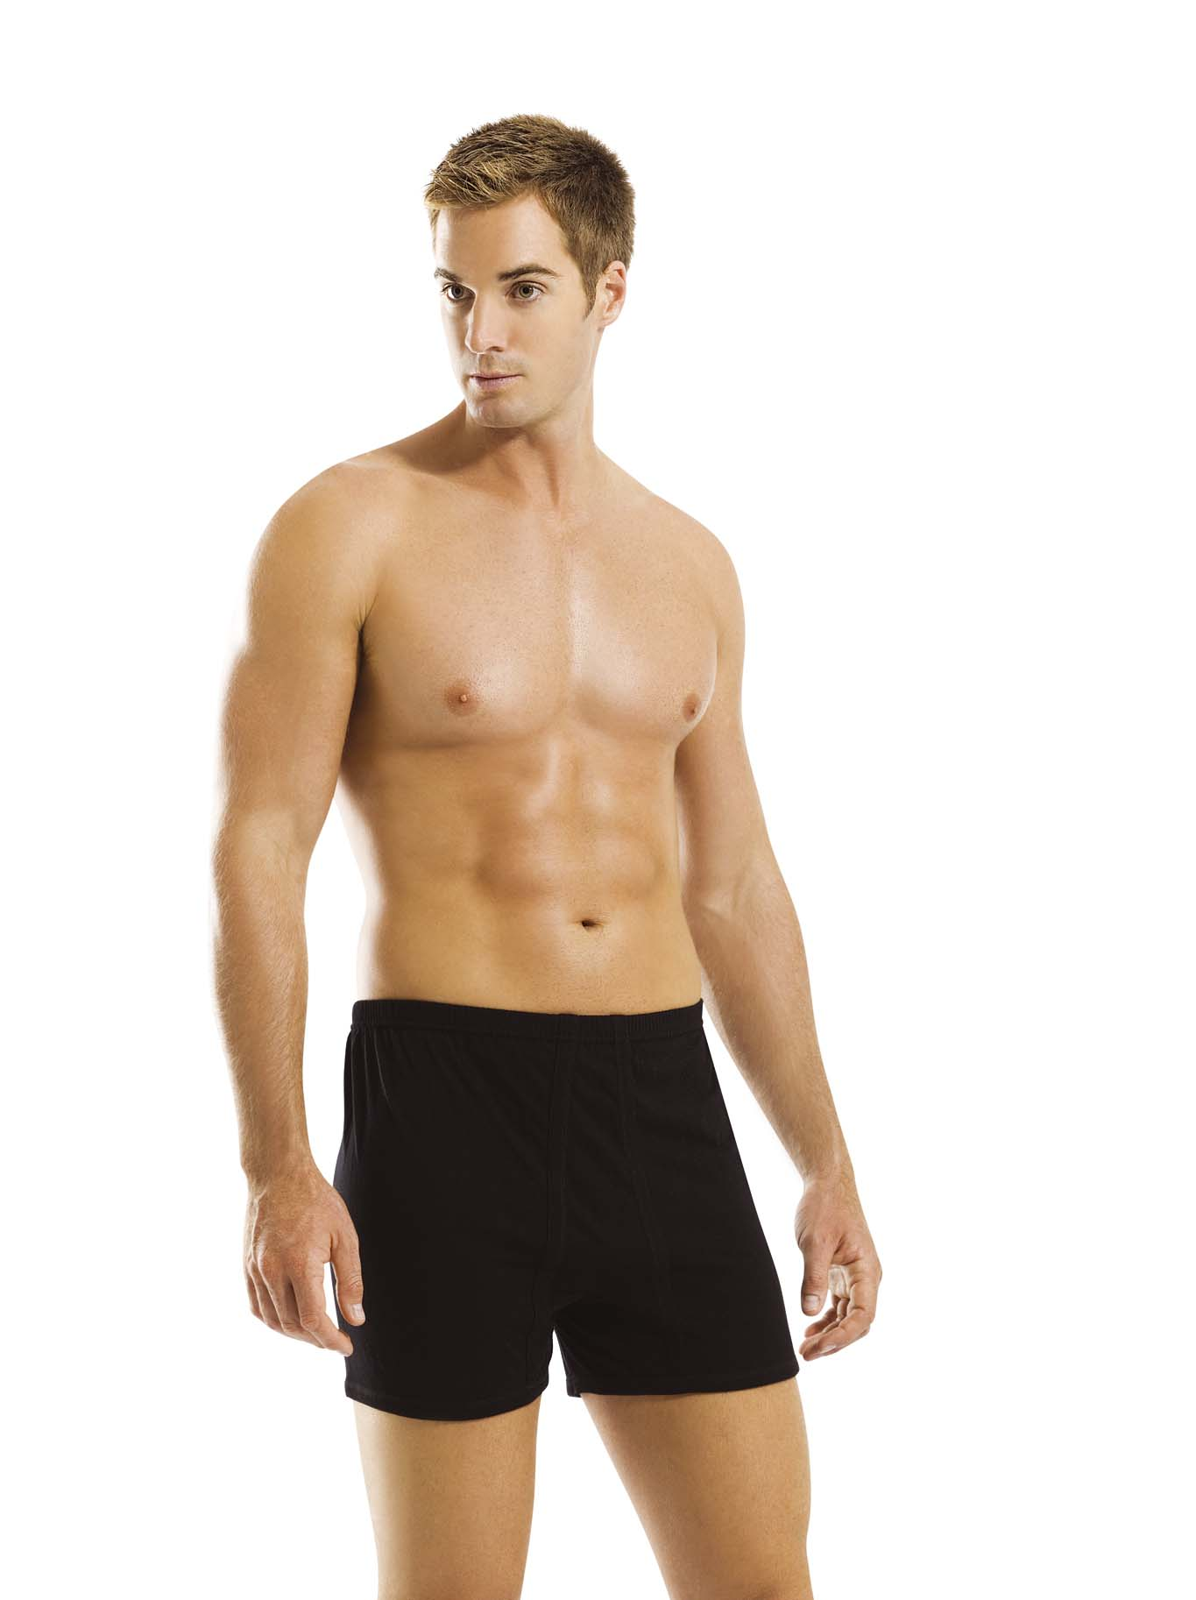
ANAYILDIZ TEKSTIL
Code: 1006
Code: 1007
Code: 1008
Black-Grey-Brown-D.Brown
Khaki-D.Blue-D.Grey

Slide 5
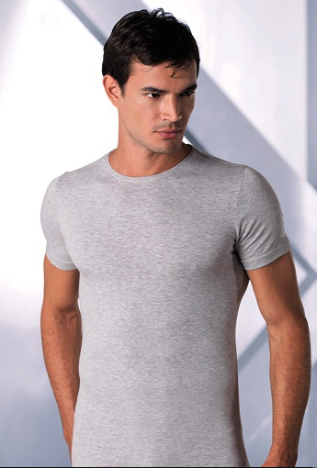
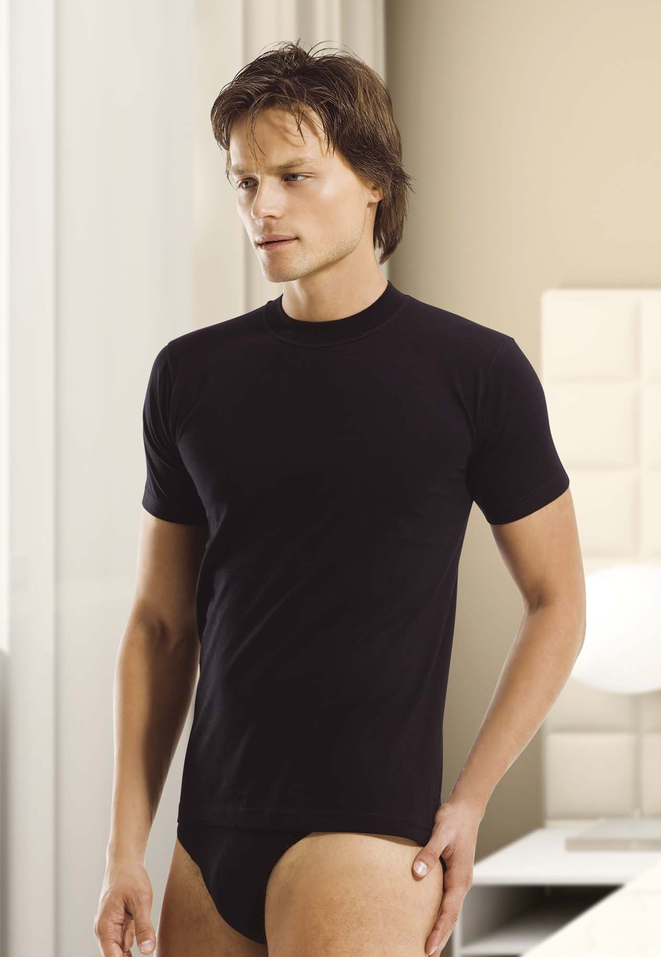
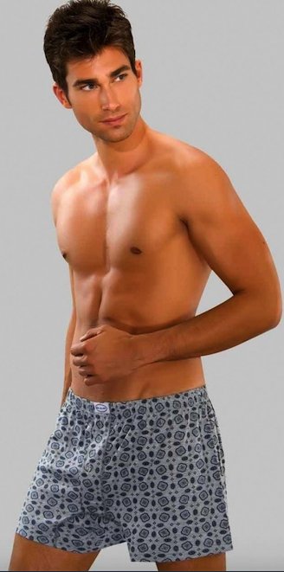
ANAYILDIZ TEKSTIL
Code: 1009
Code: 1010
Code: 1011
Black-Grey-Khaki
Printed Colours

Slide 6
ANAYILDIZ TEKSTIL
Code: 1012
SIZE: M-L-XL-XXL
Code:1014

Slide 7
ANAYILDIZ TEKSTIL
Code: 1015
Code: 1016
Code: 1017

Slide 8
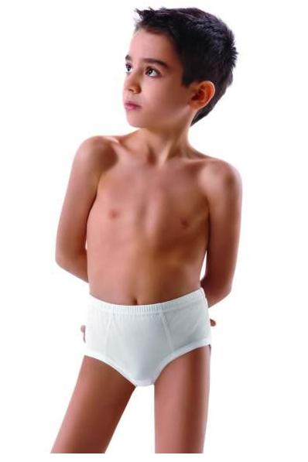
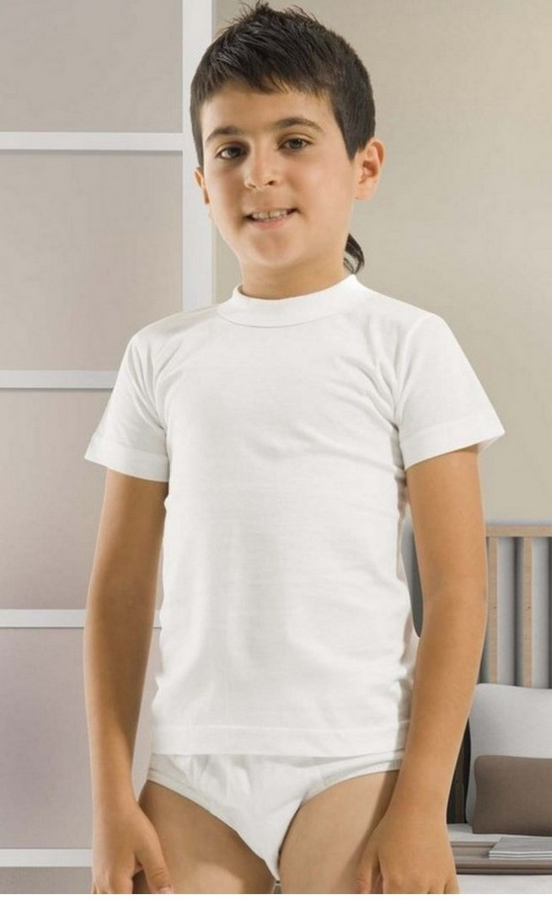
ANAYILDIZ TEKSTIL
Code: 1029
Code: 1030
Code: 1032

Slide 9
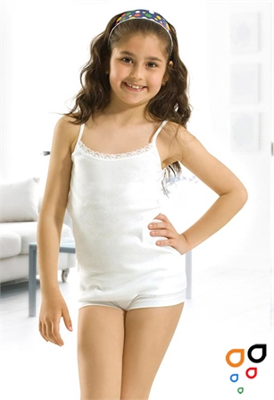
ANAYILDIZ TEKSTIL
Code: 1033
SIZE: 1-2-3-4
Code:1034

Slide 10
World gentleman club
Code:3001
Size: M-L-XL-XXL
Colours: Black-Grey-D.Grey-D.Blue-Brown-L.Brown
Code:3001C

Slide 11
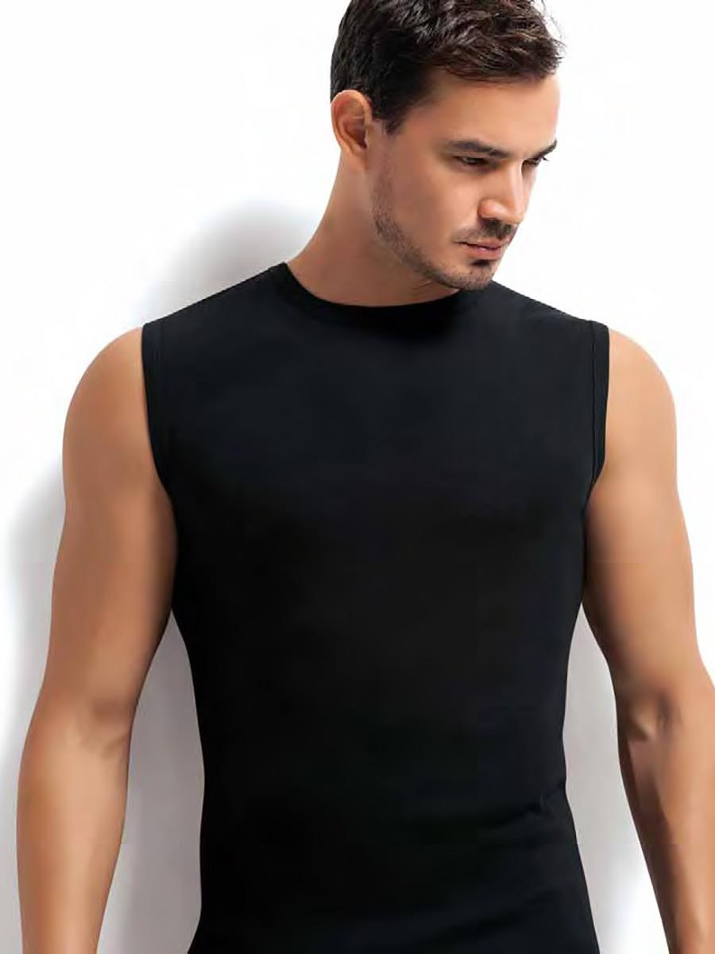
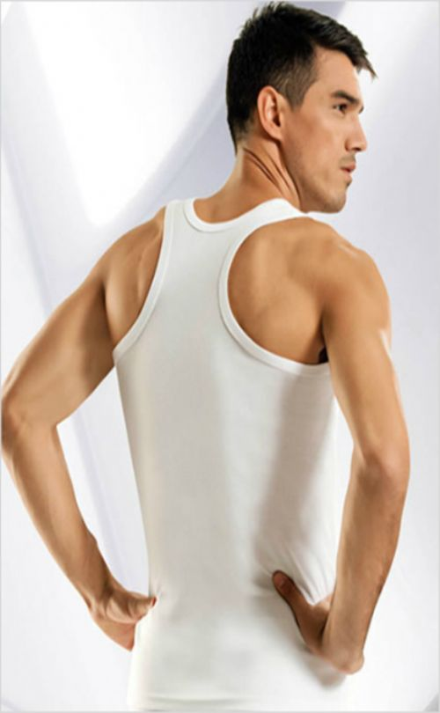
WORLD GENTLEMAN CLUB
Code: 3002
Code: 3003
Code: 3004
%100 Cotton Rib
Grey-White-Black

Slide 12
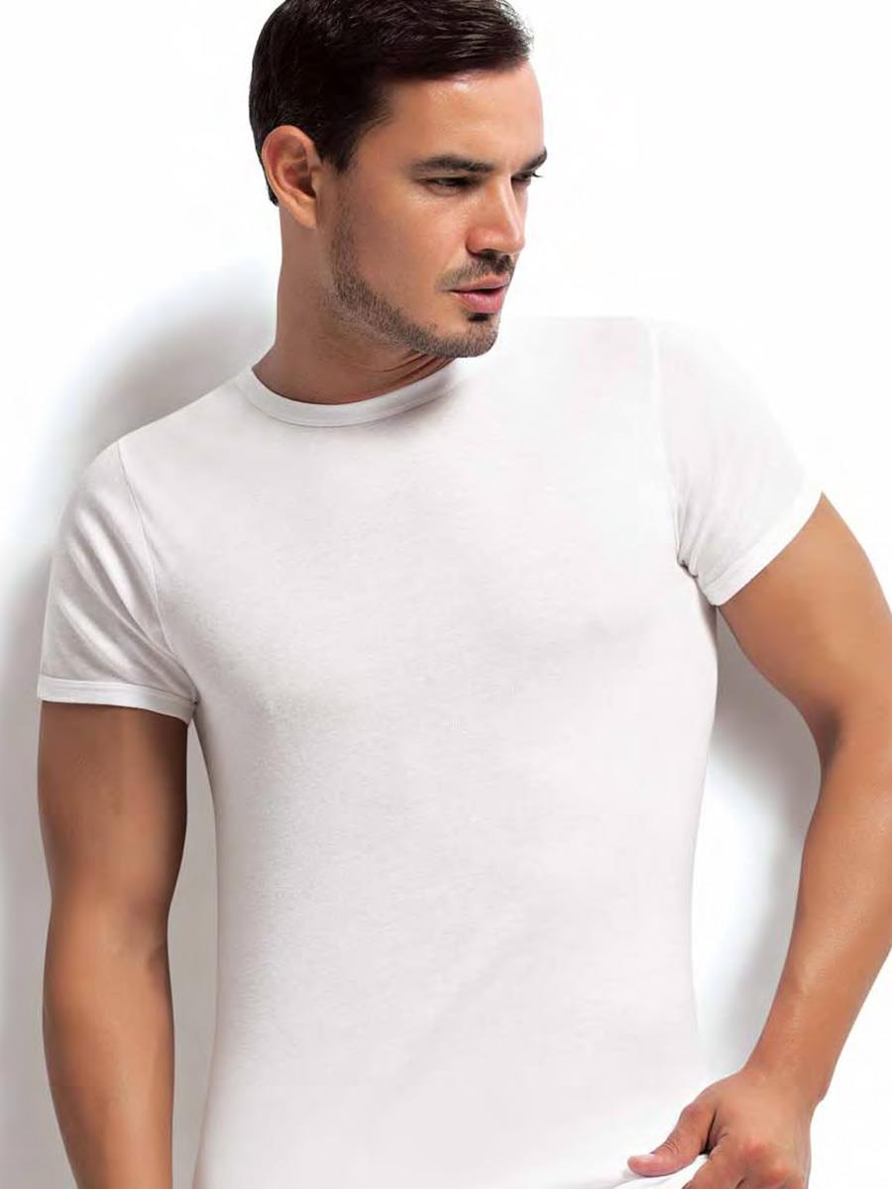
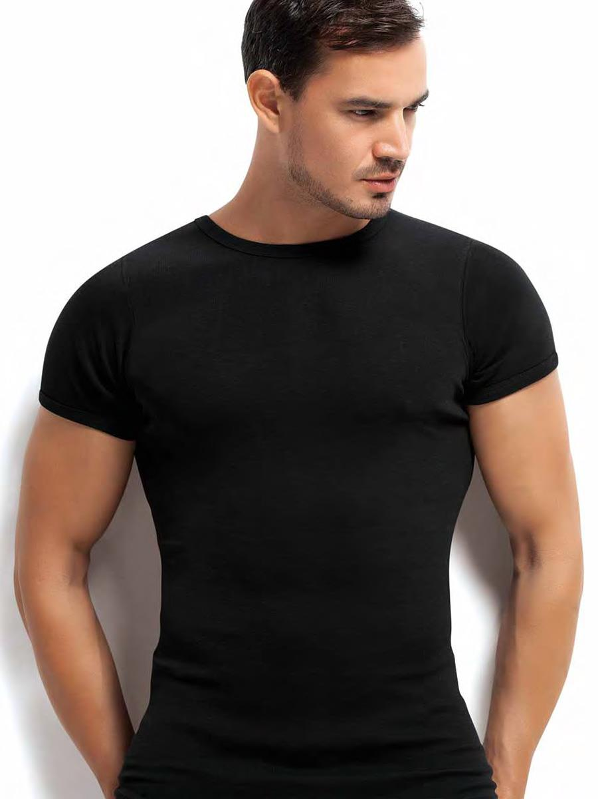
WORLD GENTLEMAN CLUB
Code: 3005
Code: 3006
Code: 3007
%100 Single Jersey Cotton
Single Packaging

Slide 13
WORLD GENTLEMAN CLUB
Code: 3008
Code: 3009
Code: 3010
%100 American Cotton
High Quality

Slide 14
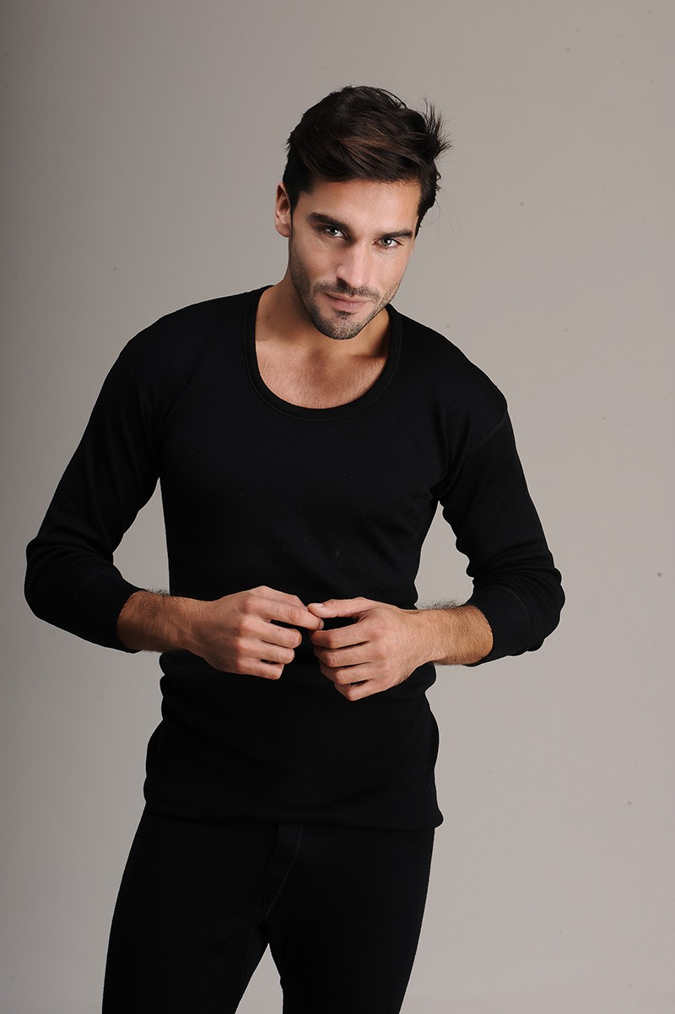
World gentleman club
Code:3011
Colour: Black-Grey-White
Size: L-XL-XXL
Code:3012

Slide 15
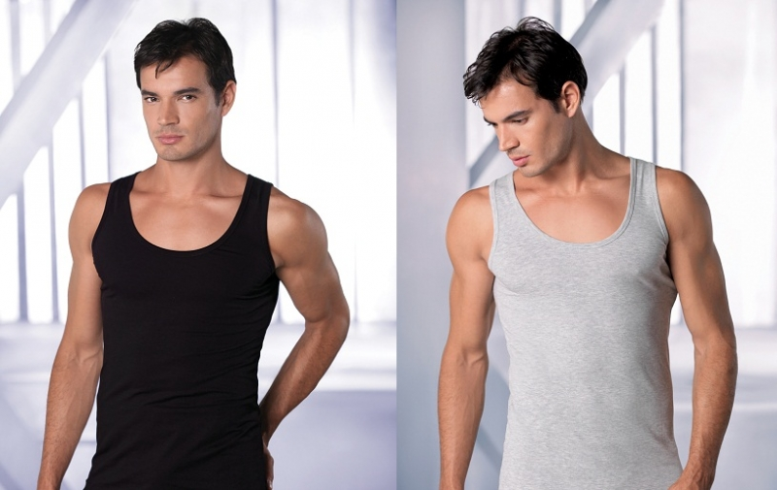
DIVA DELUXE ISTANBUL COLLECTION
Code:101
Code:101C
Colours: Black-Grey-White

Slide 16
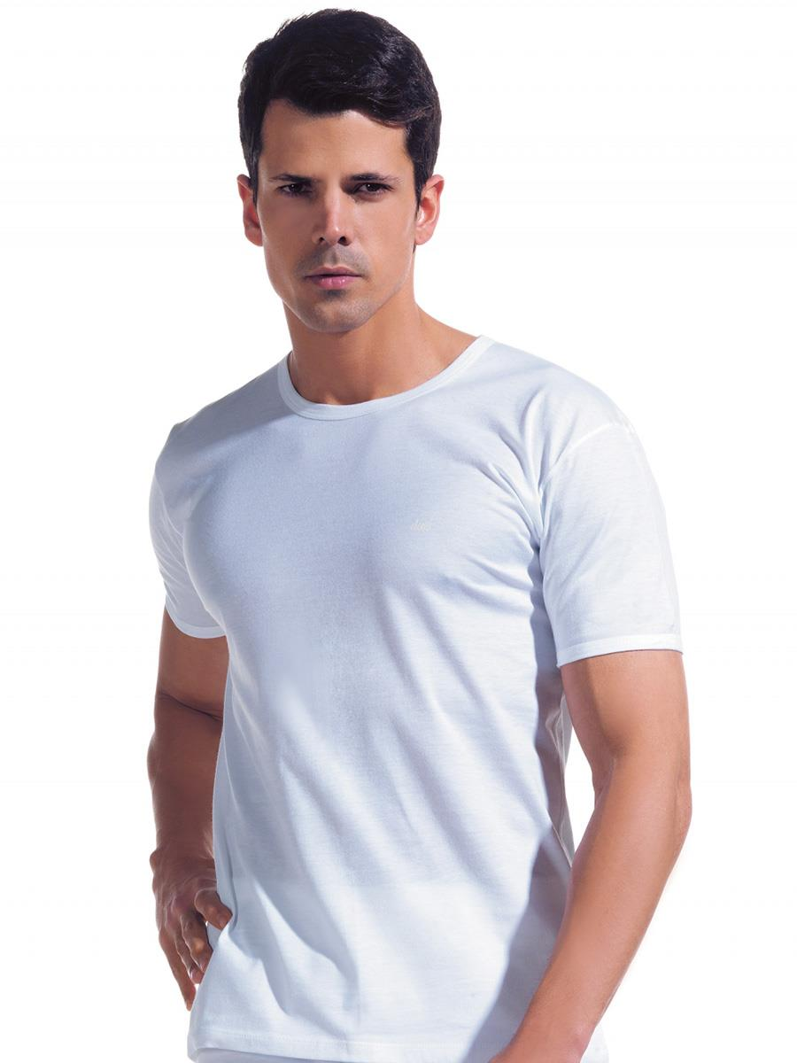
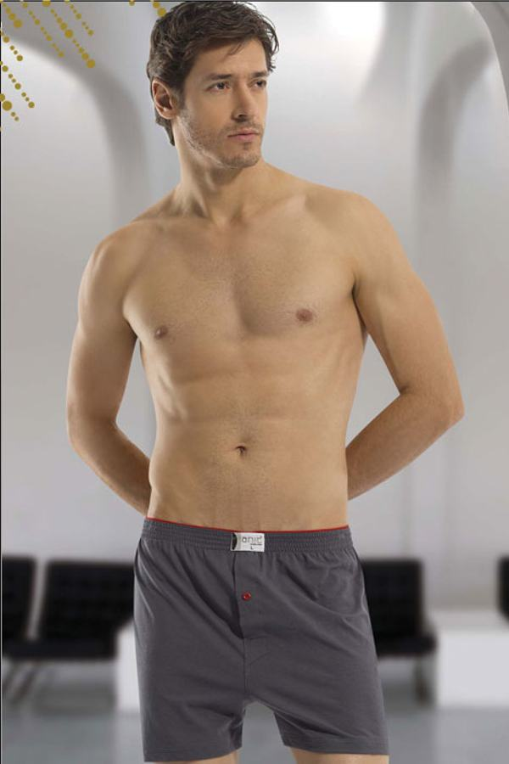
DIVA DELUXE ISTANBUL COLLECTION
Code: 102
Code: 103
Code: 104
Best Quality of ISTANBUL
%100 Combed Cotton

Slide 17
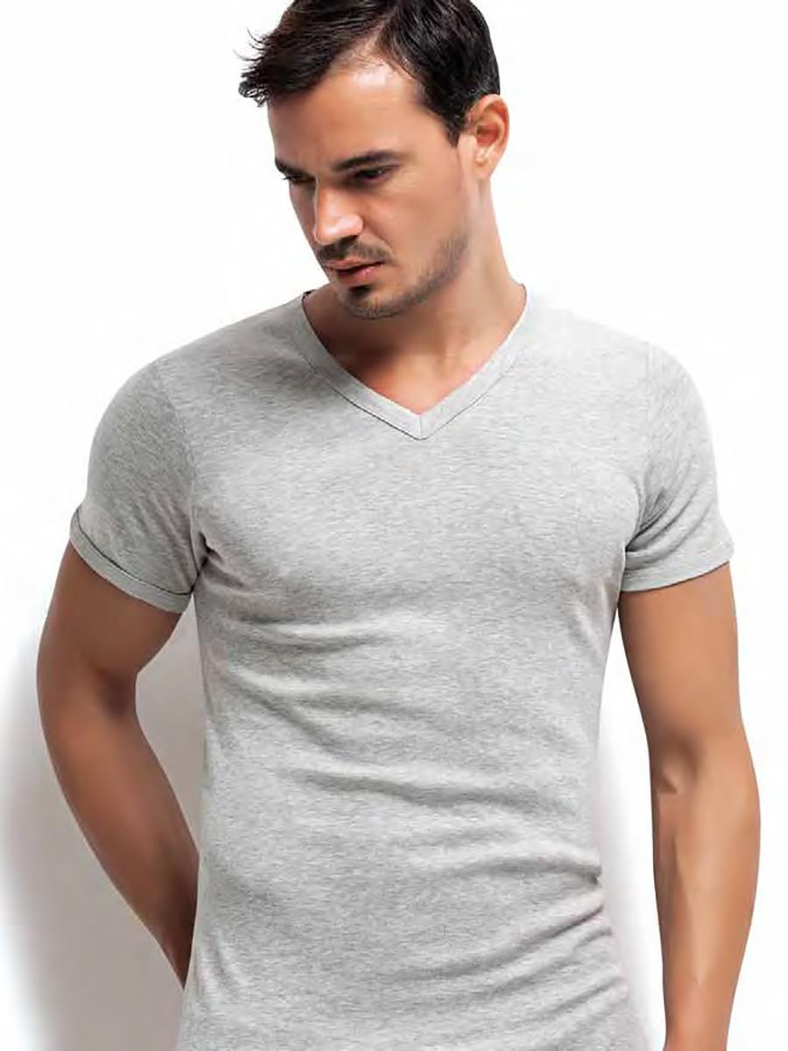
DIVA DELUXE ISTANBUL COLLECTION
Code: 105
Code: 106
Code: 108
Especially For You
Feel Best

Slide 18
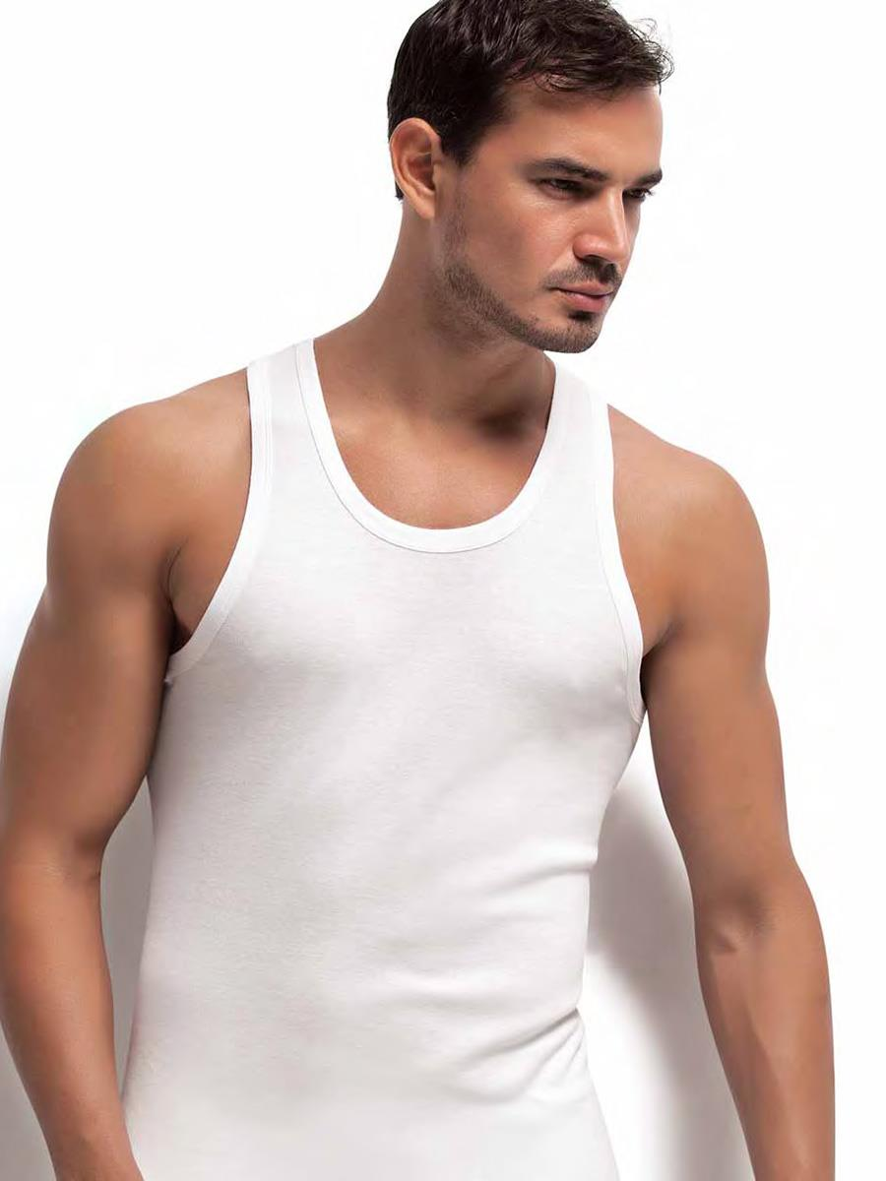
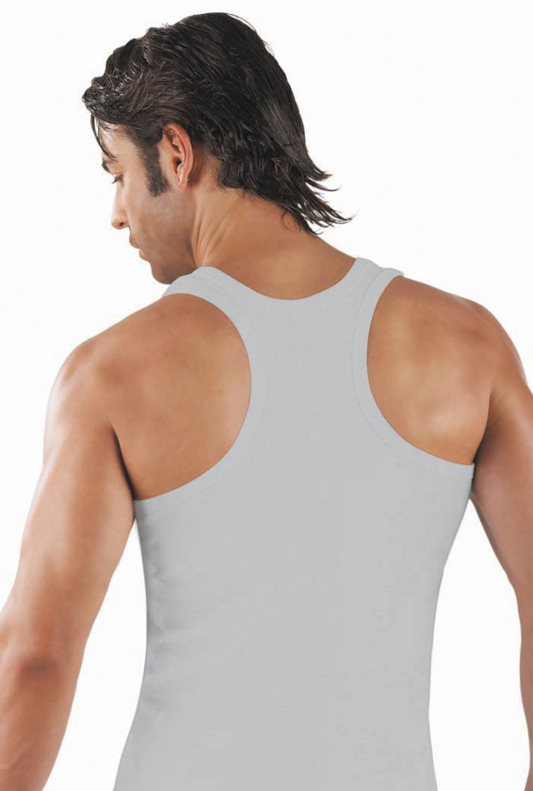
DIVA DELUXE ISTANBUL COLLECTION
Code: 109
Code: 110
Code: 111
%100 Combed Cotton Rib
Black-Grey-White

Slide 19
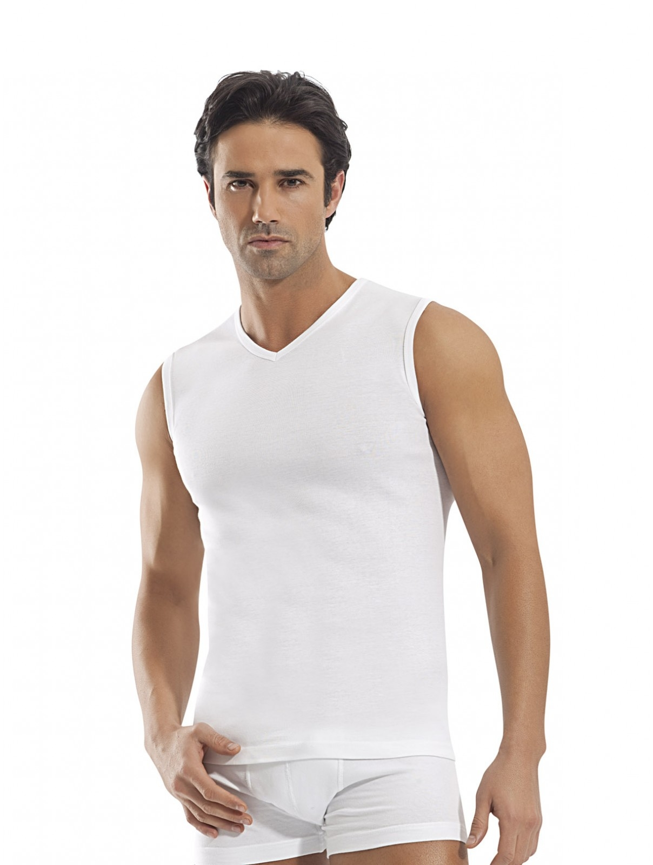
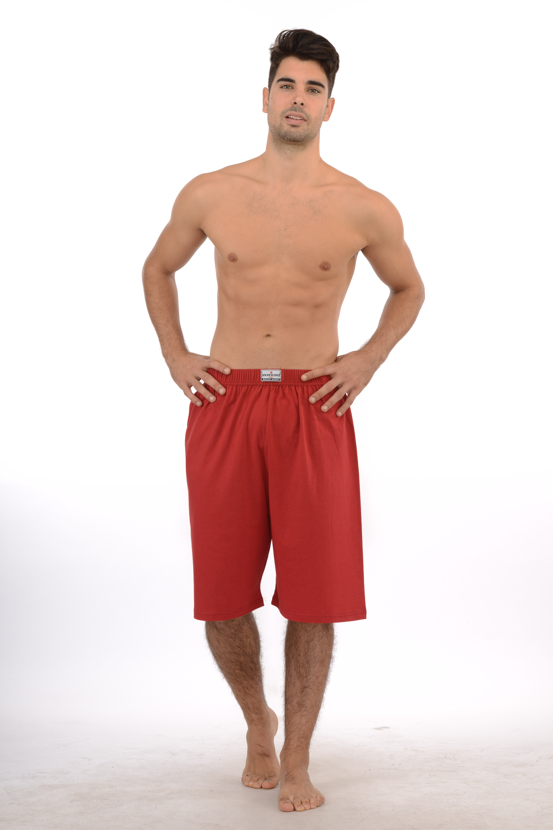
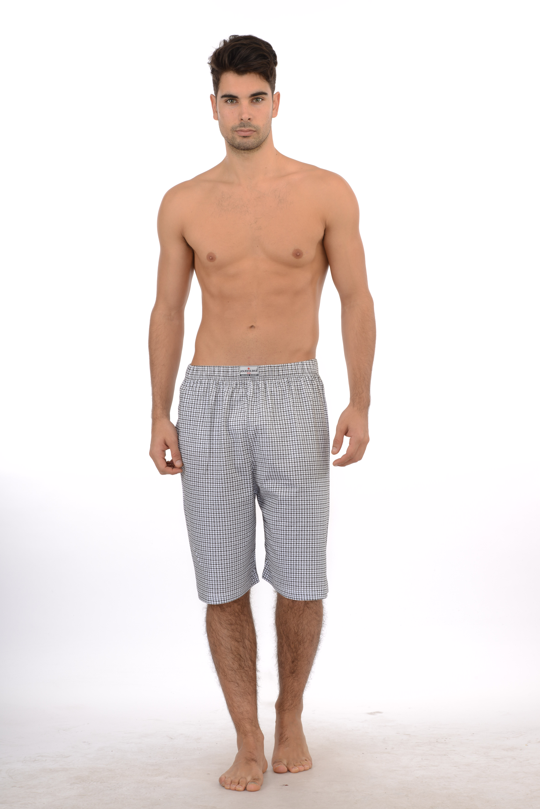
DIVA DELUXE ISTANBUL COLLECTION
Code: 112
Code: B12
Code: B11
Arabic Traditional Underwear
Feel Relax

Slide 20
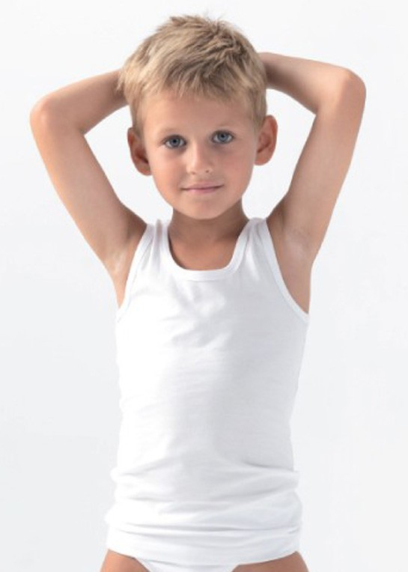
KIds club collectIon
Code:8001
Age Range: 3-4/11-12
Code:8002

Slide 21
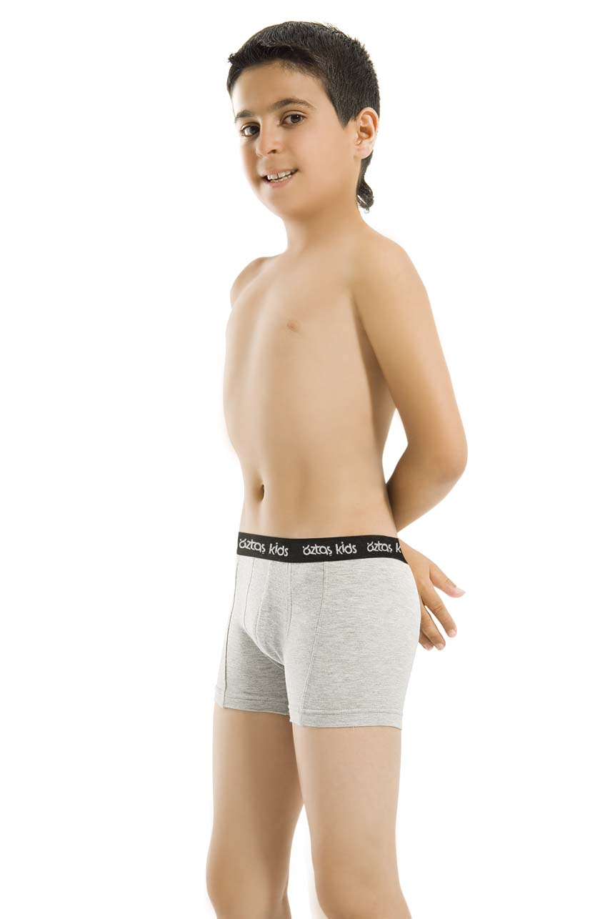
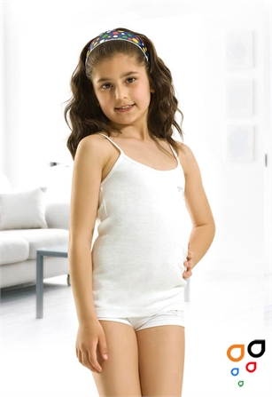
KIDS CLUB COLLECTION
Code: 8003
Code: 8004
Code: 8006
Colour: Black-Grey-White
4 Your Precious

Slide 22
AnayIldIz tekstIl
Head Office: Tarakçılar Caddesi Hamam Sokak No:3
Mahmutpasa-Fatih/ISTANBUL
Factory: Kavaklı Mahallesi Çizgi Sokak No:4 Silivri/ISTANBUL
Tel: +90(212)5227020
Fax: +90(212)5285367
www.anayildiz.com
info@anayildiz.com

